Slide 1

American Health
Team BHJ
Ben McGuire, Hudson Nebbe, Jack Olsan

Slide 2
Introduction
Data from Data.gov as a CSV
Sparse data arranged by year the sample of people was asked a given health-centered question
We wanted to apply what we had learned from class this semester to American health demographics to see what kinds of relationships there are between variables.

Slide 3
Data
Our data started with 33 columns, including:
YearStart, YearEnd, LocationAbbreviation, LocationDescription, DataSource, Class, Topic, Question, Data_Value_Unit, Data_Value_Type, Data_Value, Data_Value_Alt, Data_Value_Footnote_Symbol, Data_Value_Footnote, Low_Confidence_Limit, High_Confidence_Limit, Sample_Size, Total, Age(years), Education, Gender, Income, Race/Ethnicity, GeoLocation, ClassID, TopicID, QuestionID, DataValueTypeID, LocationID, StratificationCategory1, Stratification1, StratificationCategoryID1, StratificationID1

Slide 4

Processing Data pt. 1
Basically, a large number of the columns were either too foreign to mean anything to us (like Question ID), seemed redundant (like Class and Topic often overlapped), or the data column was just not needed (like Datasource)
The data that was pulled has rows that results were “insufficient in size”, and there were occurrences of empty rows, and our data was sparse to begin with.

Slide 5
Processing Data pt. 2
The steps we took to process the data were:
Select only the rows that were related to our project.
This meant picking out redundancies, and most ID columns
2. Build a dataframe that we could build and filter against to answer some of our questions.
3. Create additional dataframes that pertain to each individual question in the dataset so we can use this data’s questions to answer our own.

Slide 6
Questions
The questions we wanted to ask about this data set are:
How do nutrition, physical activity, and obesity metrics vary across different states?
What demographic factors (age, gender, income, education, race/ethnicity) are most associated with variations in health metrics?
Have there been significant changes over time in key metrics like obesity?
What is the relationship between socioeconomic status (e.g., income, education) and health measures like obesity and physical activity?

Slide 7
Our Procedure pt. 1
Each question we asked had a slightly different approach, but for all of them, we know we were going to refer to the `Question` column for all of them. This column contained 1 of 9 health questions that our data was built sparsely on. We classified 2 of these questions as “health outcomes” and the other 7 as “health behaviors”
A sparse example of an “outcome” question is: “Percent of adults aged 18 years and older who have obesity” where data was collected among just males making $15,000 to $29,999 a year.
A sparse example of a “behavior” question is: “Percent of adults who participate in strength training twice a week” where data was collected among just males making $15,000 to $29,999 a year.

Slide 8
Our Procedure pt. 2
For each of our group’s questions, we then related in some way.
Question 1: How do nutrition, physical activity, and obesity metrics vary across different states?
We analyzed the data per state and visualized it based on “healthy” or “unhealthy” practices / outcomes
Question 2: What demographic factors (age, gender, income, education, race/ethnicity) are most associated with variations in health metrics?
We normalized the sample size then averaged the result data value. This allowed us to compare equally all the different questions and split them out.
Question 3: Have there been significant changes over time in key metrics like obesity?
We looked at the overall sample’s results for health metrics and plotted them to see patterns.
Question 4: What is the relationship between socioeconomic status (e.g., income, education) and health measures like obesity and physical activity?
We took Income ranges and created an ANOVA with box and whisker plots to draw conclusions.

Slide 9
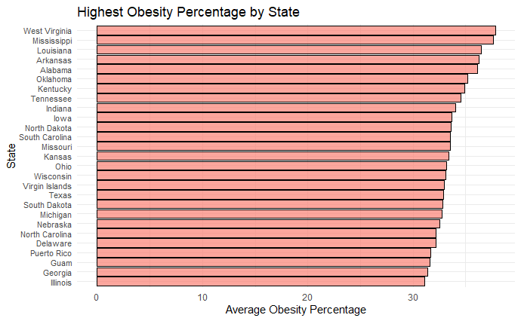
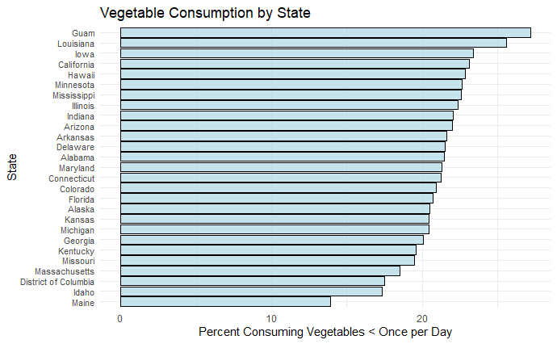
Results
Question 1: How do nutrition, physical activity, and obesity metrics vary across different states?

Slide 10
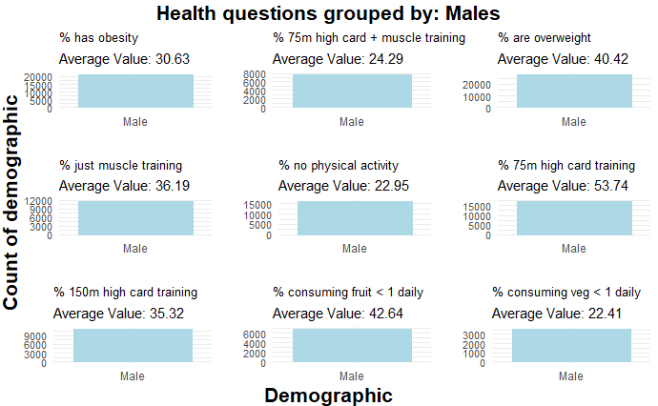
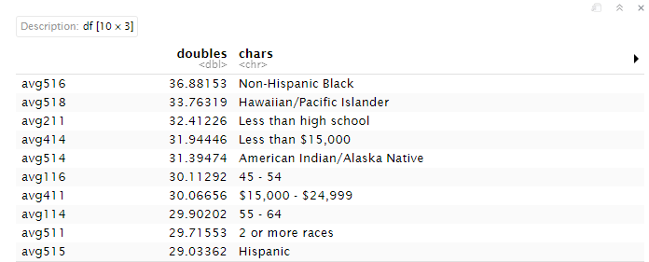
Results
Question 2: What demographic factors (age, gender, income, education, race/ethnicity) are most associated with variations in health metrics?
Highest obesity by characteristic

Slide 11
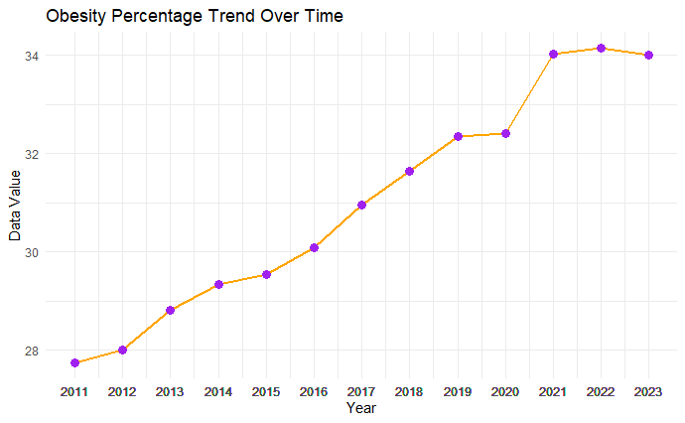
Results
Question 3: Have there been significant changes over time in key metrics like obesity?

Slide 12
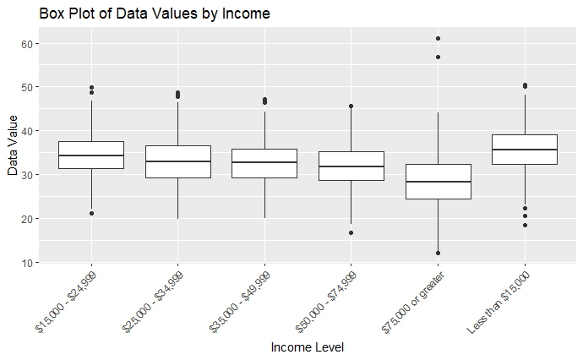
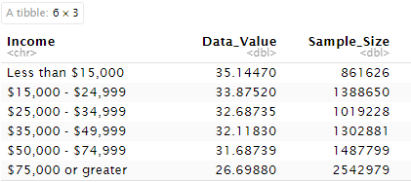
Results
Question 4: What is the relationship between socioeconomic status (e.g., income, education) and health measures like obesity and physical activity?
Obesity within income groups

Slide 13
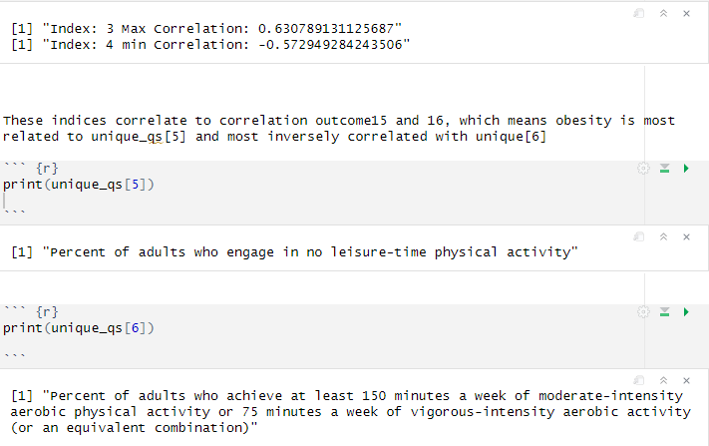
Conclusion
Really wanted to see what the most beneficial behavior is most likely to prevent obesity, so we ran a correlation for each behavior and got:

